Slide 1
Justice Reinvestment
Selected Maps from Recent Projects
www.justicemapping.org
Office Tel: 347.223.2598
Fax: 718.638.2814

Slide 2
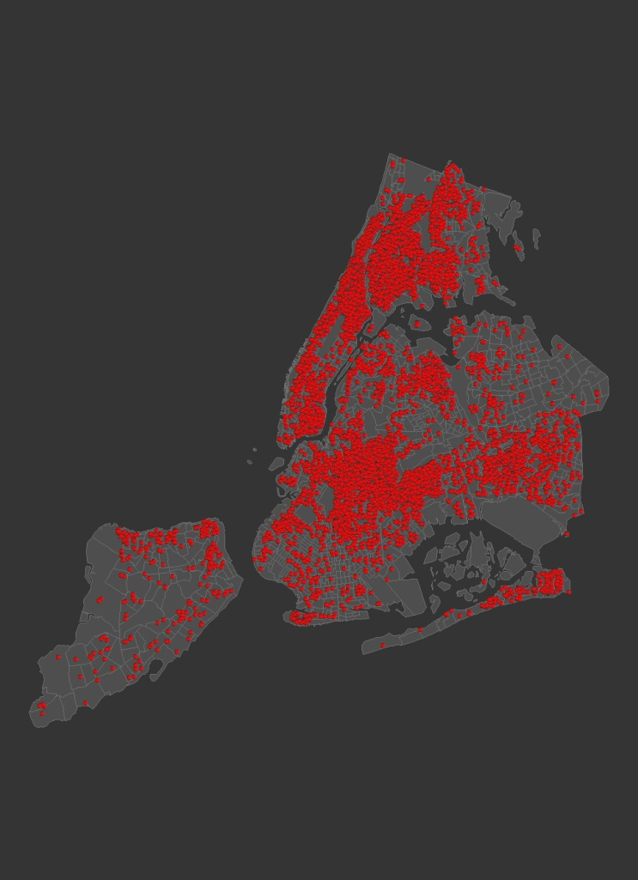
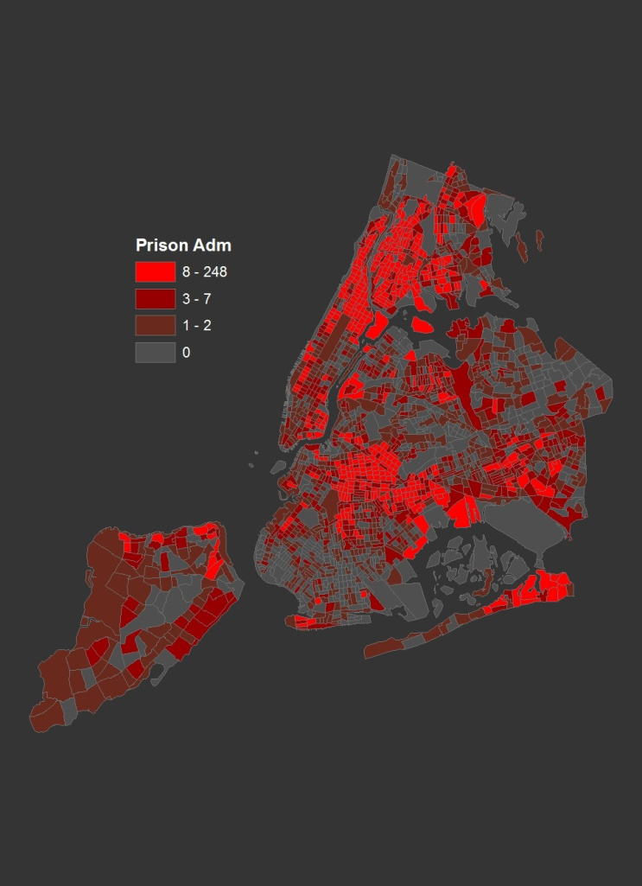
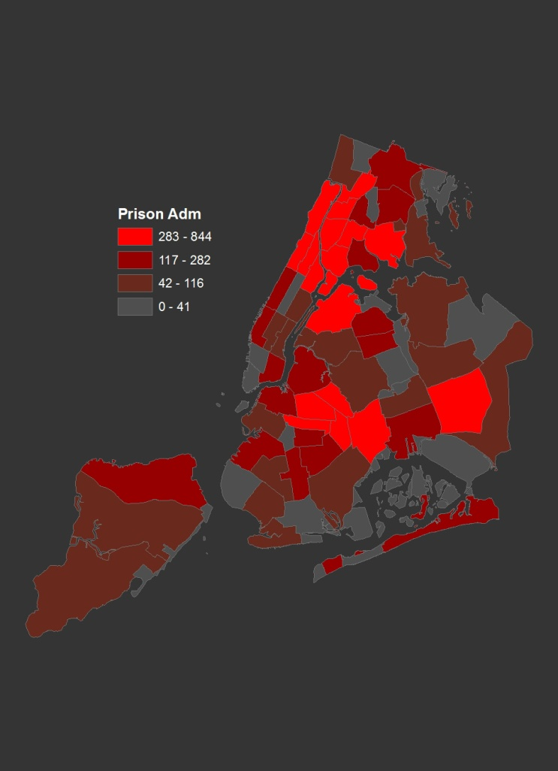
Aggregations Three Different Levels of Aggregation of the Same Data
New York City Prison Admissions, 2003
Individual Addresses
Census Tracts
Community Districts
1
www.justicemapping.org
Office Tel: 347.223.2598
Fax: 718.638.2814

Slide 3
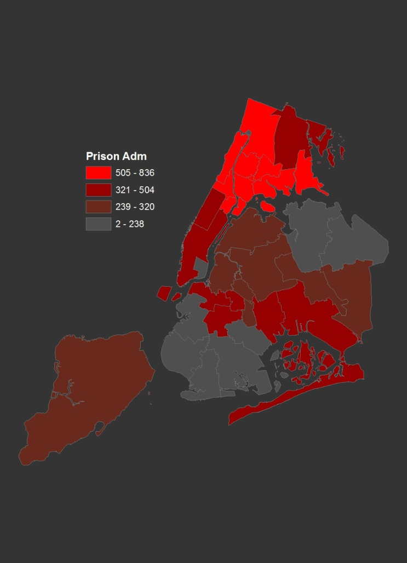
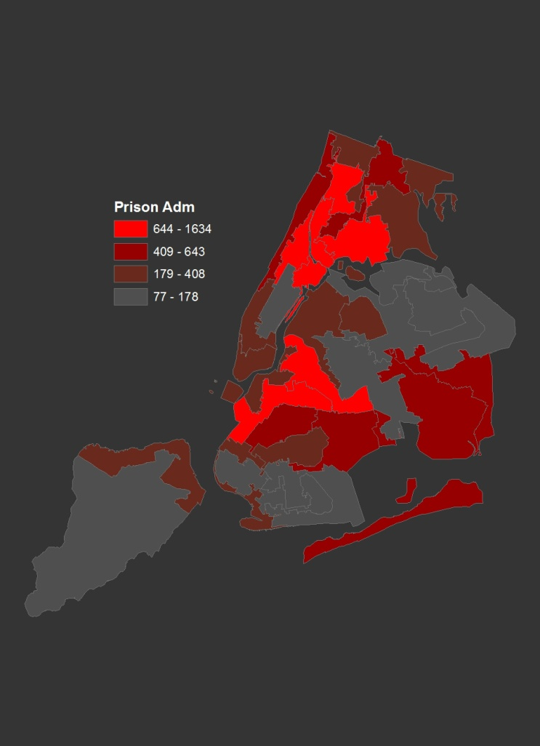
The Importance of Boundaries Three Views of the Same Data
New York City Prison Admissions, 2003
Community Districts
School Districts
State Senate Districts
www.justicemapping.org
Office Tel: 347.223.2598
Fax: 718.638.2814

Slide 4
Milwaukee Neighborhoods
Crime and Incarceration
www.justicemapping.org
Office Tel: 347.223.2598
Fax: 718.638.2814

Slide 5
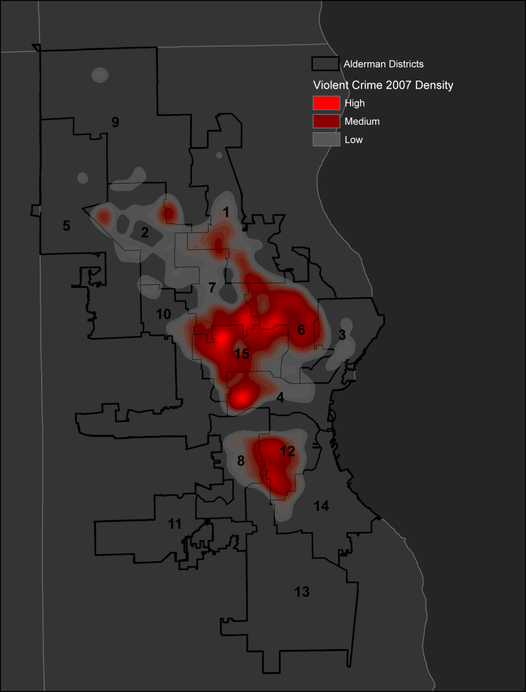
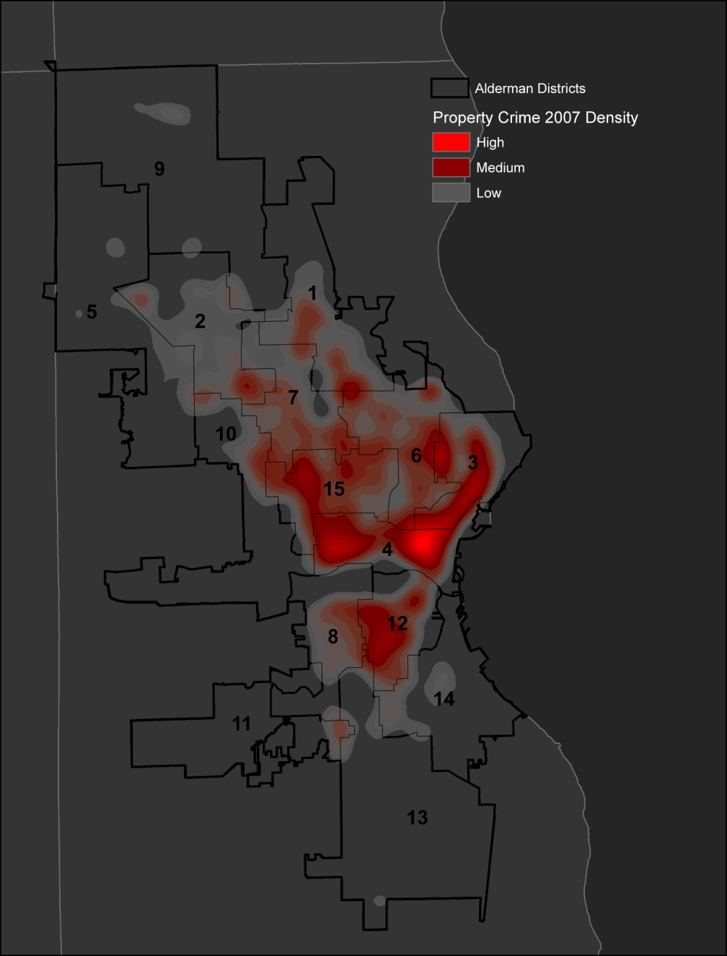
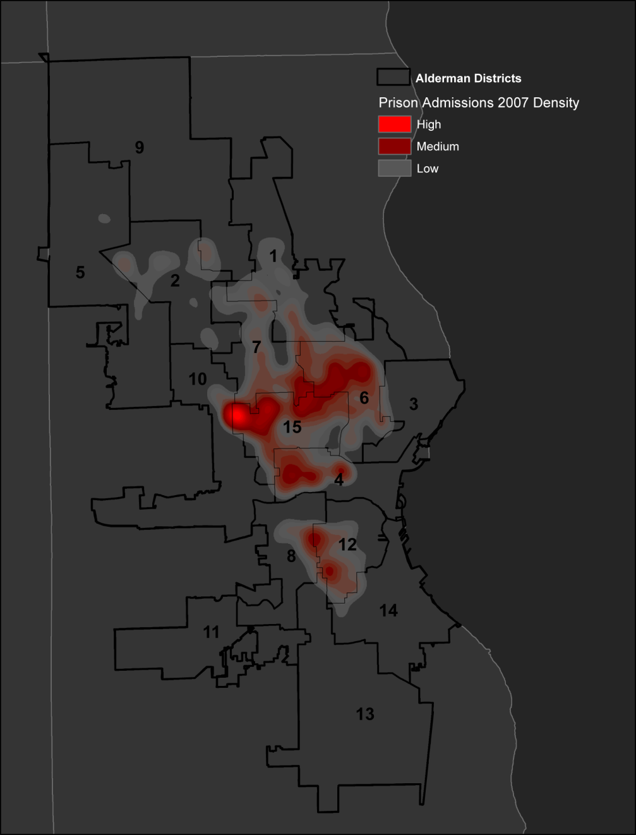
Crime v. Prison Admissions (2007) Milwaukee Incident Density
Prison Admissions
Property Crimes
Violent Crimes
District 15 | Crimes: 2,509 | Per 1000: 80.5
District 11 | Crimes: 277 | Per 1000: 8.1
The highest violent crime rate Alderman District is 10 times higher than the lowest violent crime rate District.
District 15 | Crimes: 3,334 | Per 1000: 109.0
District 11 | Crimes: 1,075 | Per 1000: 31.3
The highest property crime rate Alderman District is only 3.5 times higher than the lowest property crime rate District.
District 15 | Prison Adm.: 420 | Per 1000: 29.5
District 11 | Prison Adm.: 46 | Per 1000: 1.5
Prison admissions are more concentrated than either violent or property crime. The highest prison admission rate Alderman District is 19 times higher than the lowest prison admission rate District.
Data Source: Milwaukee Police Department and Wisconsin Department of Corrections Maps: Justice Mapping Systems

Slide 6
New York City Neighborhoods
Prison Admissions & Expenditures
www.justicemapping.org
Office Tel: 347.223.2598
Fax: 718.638.2814

Slide 7
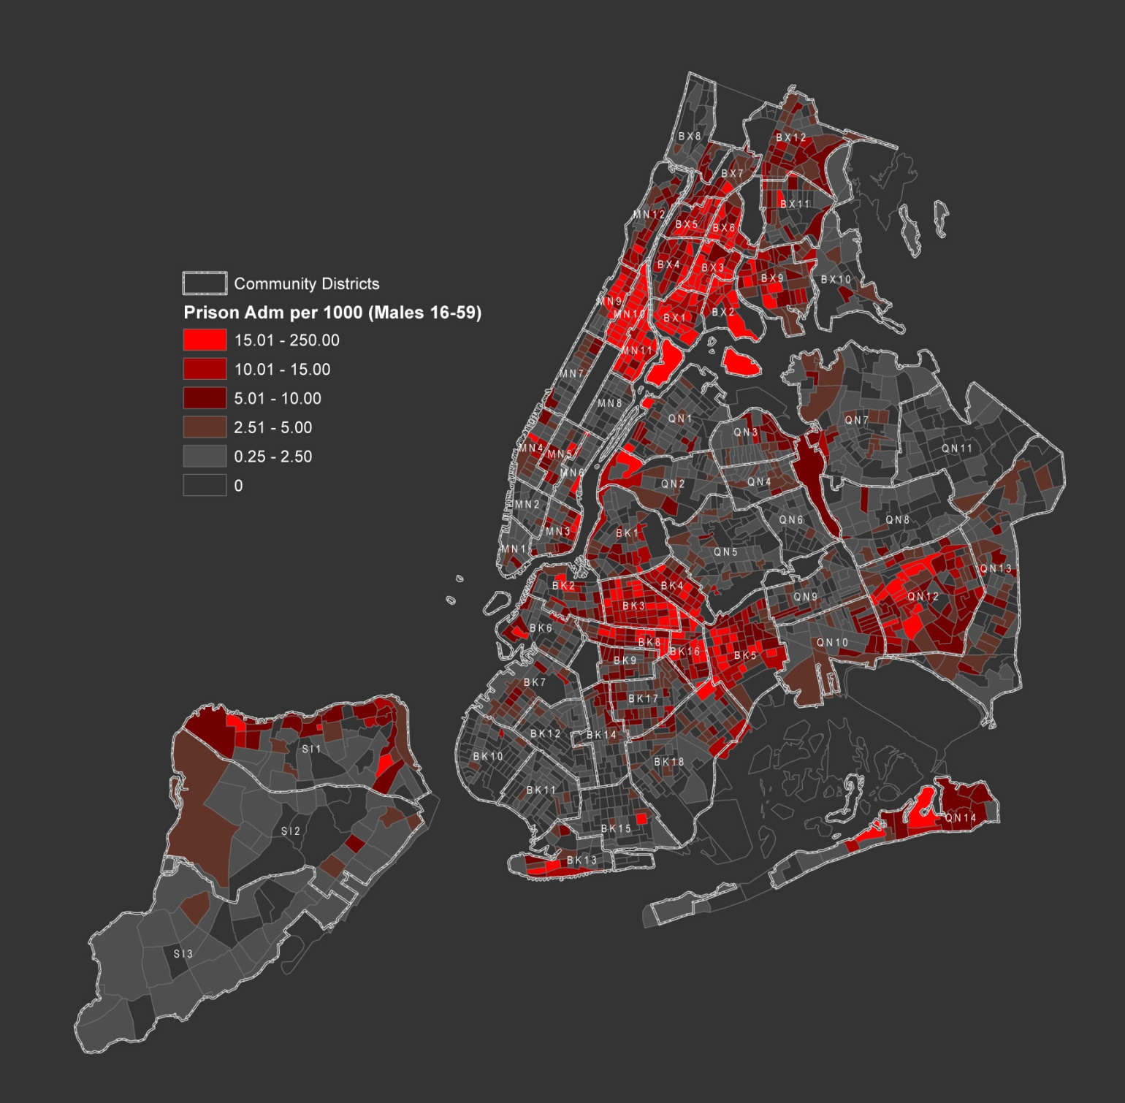
Men Admitted to Prison
New York City
Per 1000 Adult Males
(16–59)
Census Tracts
with Community Districts
Admissions per 1000
Boro | CD | Count | Rate
MN | 10 | 748 | 25.7
MN | 11 | 671 | 19.8
BX | 3 | 328 | 19.2
BX | 2 | 226 | 17.4
BX | 1 | 358 | 16.8
BX | 5 | 531 | 14.7
BK | 3 | 516 | 13.7
BK | 16 | 274 | 13.7
BX | 6 | 249 | 12.8
BK | 8 | 289 | 12.1
MN | 9 | 423 | 11.8
BX | 4 | 396 | 10.6
BK | 5 | 457 | 10.1
www.justicemapping.org
Office Tel: 347.223.2598
Fax: 718.638.2814

Slide 8
Men Admitted to Prison
New York City
Per 1000 Adult Males
(16–59)
Census Tracts
with Community Districts
Admissions per 1000
Boro | CD | Count | Rate
MN | 10 | 748 | 25.7
MN | 11 | 671 | 19.8
BX | 3 | 328 | 19.2
BX | 2 | 226 | 17.4
BX | 1 | 358 | 16.8
BX | 5 | 531 | 14.7
BK | 3 | 516 | 13.7
BK | 16 | 274 | 13.7
BX | 6 | 249 | 12.8
BK | 8 | 289 | 12.1
MN | 9 | 423 | 11.8
BX | 4 | 396 | 10.6
BK | 5 | 457 | 10.1
www.justicemapping.org
Office Tel: 347.223.2598
Fax: 718.638.2814

Slide 9
Men Admitted to Prison
New York City
Per 1000 Adult Males
(16–59)
Census Tracts
with Community Districts
Admissions per 1000
Boro | CD | Count | Rate
MN | 10 | 748 | 25.7
MN | 11 | 671 | 19.8
BX | 3 | 328 | 19.2
BX | 2 | 226 | 17.4
BX | 1 | 358 | 16.8
BX | 5 | 531 | 14.7
BK | 3 | 516 | 13.7
BK | 16 | 274 | 13.7
BX | 6 | 249 | 12.8
BK | 8 | 289 | 12.1
MN | 9 | 423 | 11.8
BX | 4 | 396 | 10.6
BK | 5 | 457 | 10.1
www.justicemapping.org
Office Tel: 347.223.2598
Fax: 718.638.2814

Slide 10
Men Admitted to Prison
New York City
Per 1000 Adult Males
(16–59)
Census Tracts
with Community Districts
Admissions per 1000
Boro | CD | Count | Rate
MN | 10 | 748 | 25.7
MN | 11 | 671 | 19.8
BX | 3 | 328 | 19.2
BX | 2 | 226 | 17.4
BX | 1 | 358 | 16.8
BX | 5 | 531 | 14.7
BK | 3 | 516 | 13.7
BK | 16 | 274 | 13.7
BX | 6 | 249 | 12.8
BK | 8 | 289 | 12.1
MN | 9 | 423 | 11.8
BX | 4 | 396 | 10.6
BK | 5 | 457 | 10.1
www.justicemapping.org
Office Tel: 347.223.2598
Fax: 718.638.2814

Slide 11
Men Admitted to Prison
New York City
Per 1000 Adult Males
(16–59)
Census Tracts
with Community Districts
Percent of City Total
Boro | CD | Men sent to Prison | All Adult Males
MN | 10 | 6.45% | 1.21%
MN | 11 | 5.79% | 1.41%
BX | 3 | 2.83% | 0.71%
BX | 2 | 1.95% | 0.54%
BX | 1 | 3.09% | 0.89%
BX | 5 | 4.58% | 1.50%
BK | 3 | 4.45% | 1.56%
BK | 16 | 2.36% | 0.83%
BX | 6 | 2.15% | 0.81%
BK | 8 | 2.49% | 0.99%
MN | 9 | 3.65% | 1.50%
BX | 4 | 3.42% | 1.56%
BK | 5 | 3.94% | 1.89%
BX | 9 | 3.55% | 1.87%
TOTAL |  | 50.72% | 17.27%
These Districts are home to 17% of the City’s adult male residents,
but account for over 50% of men sent to prison from the City.
www.justicemapping.org
Office Tel: 347.223.2598
Fax: 718.638.2814

Slide 12
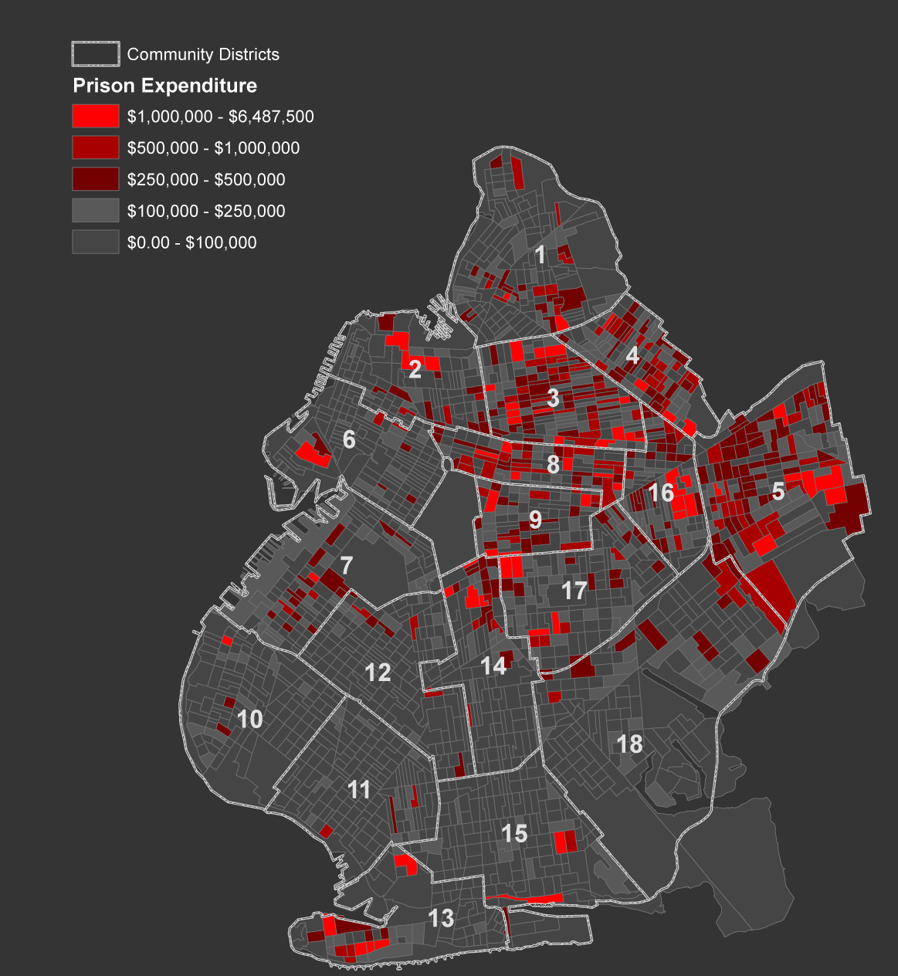
Prison Expenditures
Brooklyn
Census Block Groups with Community Districts
(2003)
CD | Expenditures (in Millions)
3 | $58.7
5 | $50.2
8 | $34.9
4 | $33.9
16 | $33.5
17 | $19.3
1 | $19.1
14 | $16.7
9 | $15.6
2 | $14.6
7 | $12.9
13 | $11.8
18 | $9.4
6 | $8.7
12 | $6.1
15 | $5.4
11 | $4.7
10 | $4.0
www.justicemapping.org
Office Tel: 347.223.2598
Fax: 718.638.2814

Slide 13
Phoenix Neighborhoods
Criminal Justice & Health and Human Services Populations
www.justicemapping.org
Office Tel: 347.223.2598
Fax: 718.638.2814

Slide 14
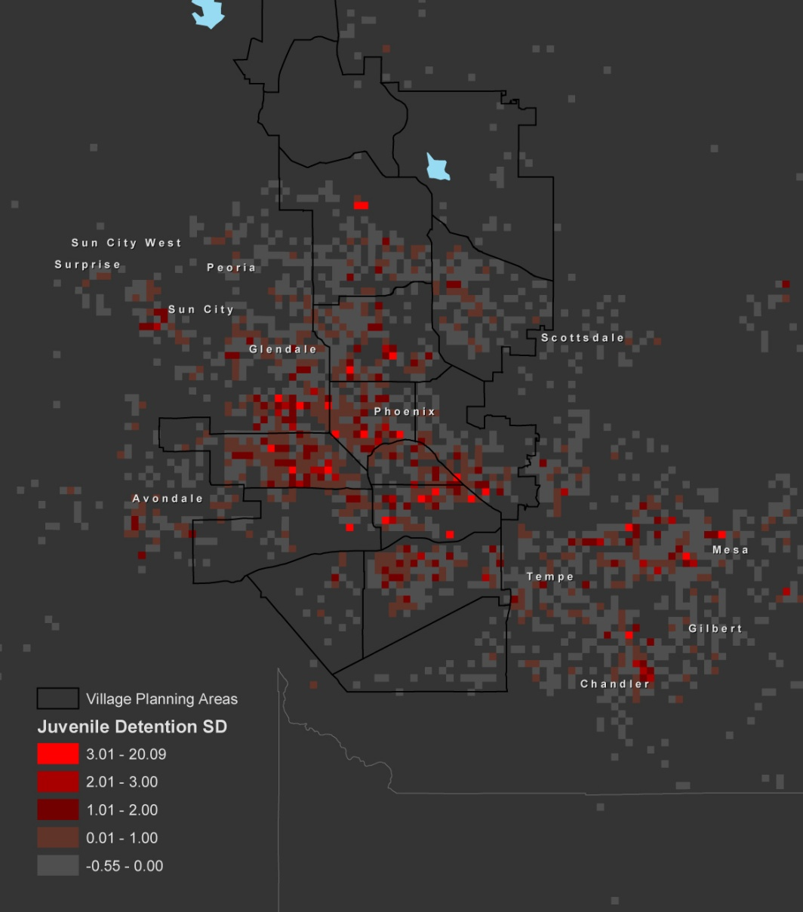
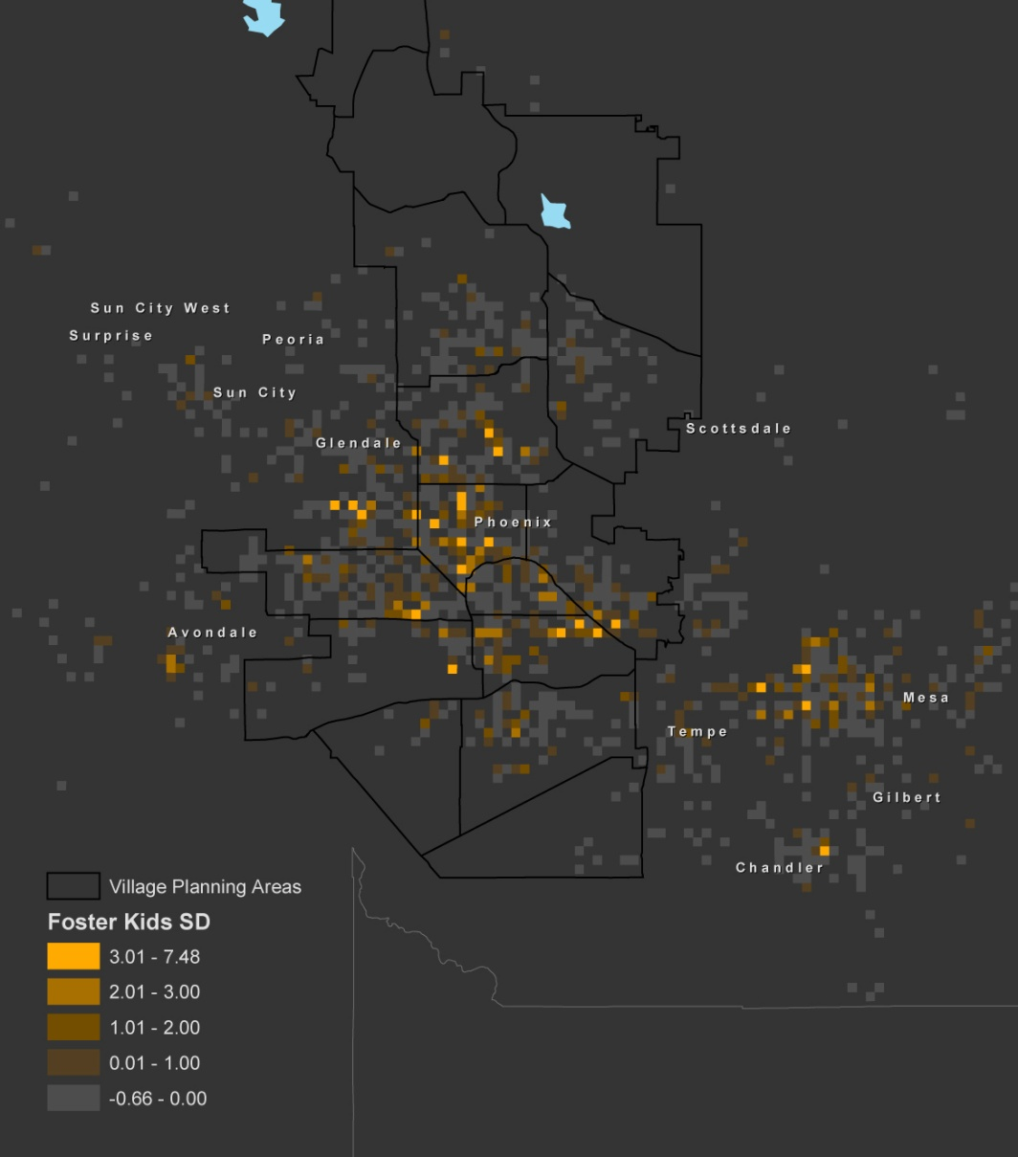
Comparison of Populations (Phoenix, Arizona)
Measured in Standard Deviations from the Mean (1/2 Mile Grid Map with Village Planning Areas)
Juveniles Admitted to Detention
(Residence, 2004)
Children in Out of Home Care
(Place of Origin, 10/2004 – 9/2005)
www.justicemapping.org
Office Tel: 347.223.2598
Fax: 718.638.2814

Slide 15
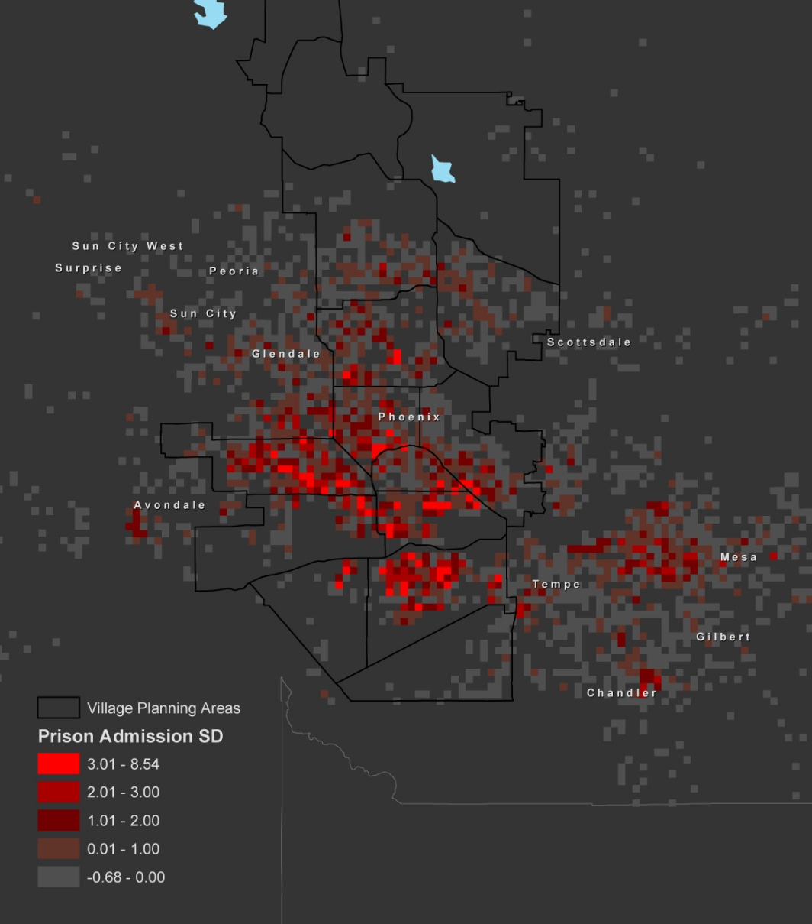
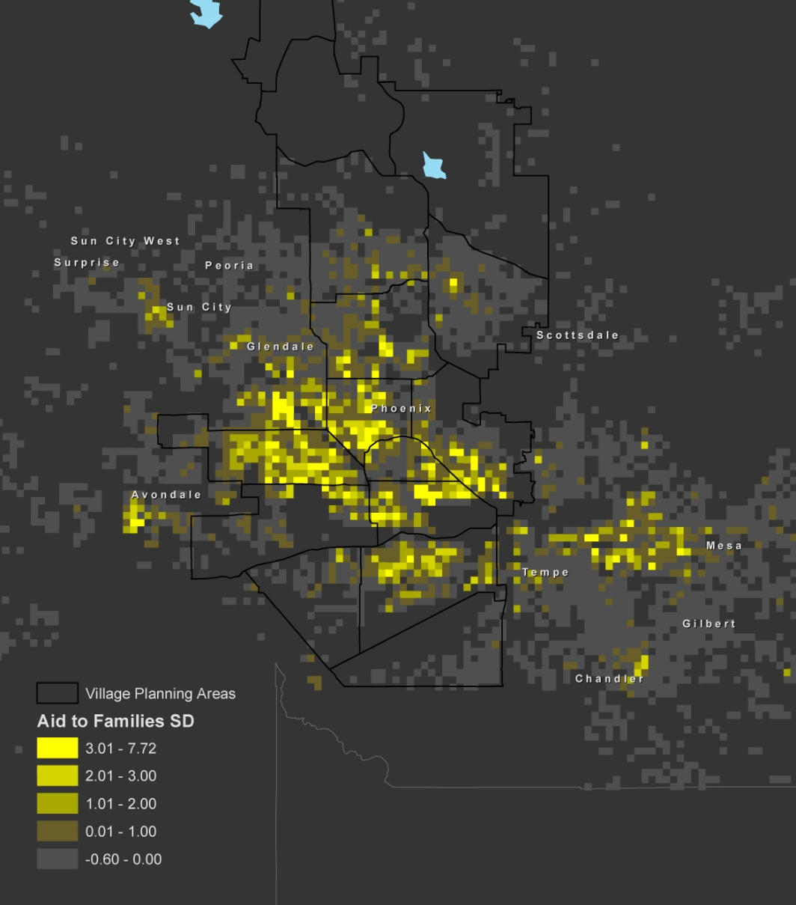
Comparison of Populations (Phoenix, Arizona)
Measured in Standard Deviations from the Mean (1/2 Mile Grid Map with Village Planning Areas)
Medical Assistance
Recipients, 10/2004 – 9/2005
Temporary Assistance to Needy Families
Recipients, 10/2004 – 9/2005
Food Stamps
Recipients, 10/2004 – 9/2005
People Admitted to Prison
(Residence, 2004)
Temporary Assistance to Needy Families
(Place of Origin, 10/2004 – 9/2005)
www.justicemapping.org
Office Tel: 347.223.2598
Fax: 718.638.2814

Slide 16
Houston Neighborhoods
Prison Reentry & Schools
www.justicemapping.org
Office Tel: 347.223.2598
Fax: 718.638.2814

Slide 17
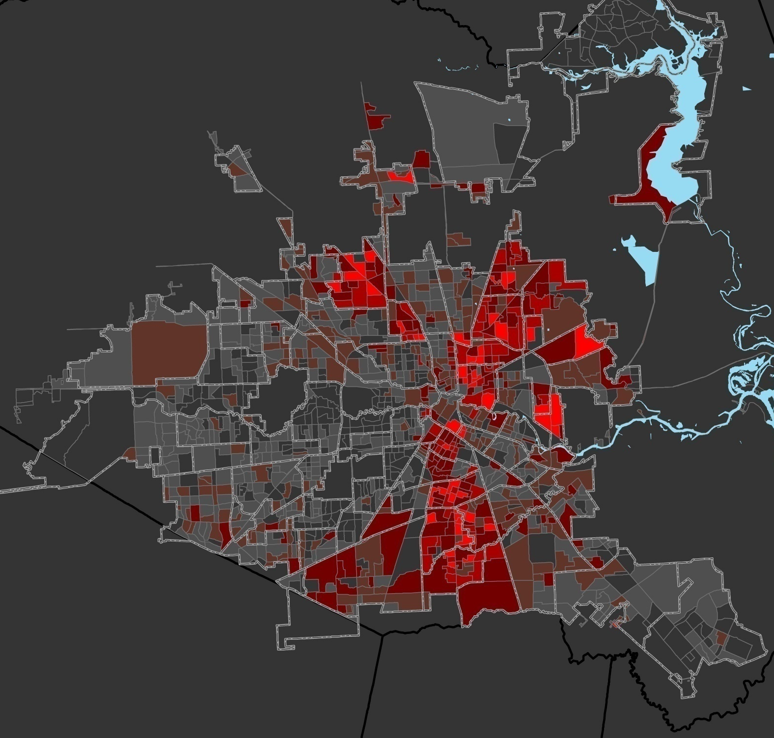
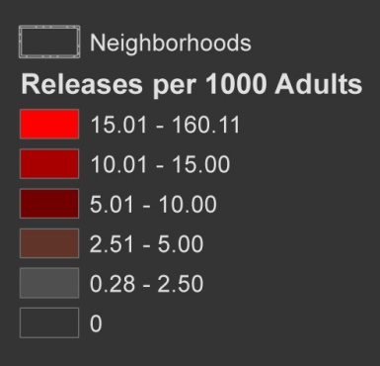
Discretionary Releases from Prison
Per 1000 Adults
Houston
Block Groups
Neighborhood Borders
And while they account for only 5% of the City’s adult population, they are home to more than 25% of the City’s returning prisoners.
6
Percent of City Total
2
1
4
Neighborhood | % Total Prison | % Total Pop.
(1) El Dorado | 3.6% | 0.1%
(2) Kashmere Area | 3.4% | 0.6%
(3) South Park | 3.9% | 0.9%
(4) Greater Fifth Ward | 3.6% | 0.9%
(5) South Acres- Crestmont Park | 2.9% | 0.7%
(6) Acres Homes | 4.3% | 1.0%
(7) OST- South Union | 3.3% | 0.8%
Total | 25.1% | 5.1%
7
3
5
www.justicemapping.org
Office Tel: 347.223.2598
Fax: 718.638.2814

Slide 18
Prison Release and School Performance
Correlation Summary
A simple correlation analysis among prison release factors and school performance factors finds some strong relationships among certain variables—highlighted in red (with scores over .300)—and an absence of strong relationships where we might have expected some (scores under .200)
 | No. of Prisoners Released | Prisoners Per 1000 | % Passed All Tests | Grad Rate | Dropout Rate | Avg. SAT Score | Disciplinary Placement % | % Disadvantaged | % LEP | Expend per Student
Prisoners Released | 1 | .502 | -.249 | -.258 | .363 | -.033 | -.081 | .305 | .206 | .000
Prisoners/1000 | .502 | 1 | -.336 | -.269 | .246 | .001 | .068 | .185 | .098 | .001
% Passed All Tests | -.249 | -.336 | 1 | .602 | -.327 | .408 | -.042 | -.431 | -.263 | -.194
Grad Rate | -.258 | -.269 | .602 | 1 | -.213 | .505 | .160 | -.235 | -.171 | -.162
Dropout Rate | .363 | .246 | -.327 | -.213 | 1 | -.097 | .034 | .283 | .186 | .009
Avg. SAT Score | -.033 | .001 | .408 | .505 | -.097 | 1 | .200 | -.280 | -.079 | -.159
Disciplinary Placement % | -.081 | .068 | -.042 | .160 | .034 | .200 | 1 | .036 | .017 | -.034
% Disadvantaged | .305 | .185 | -.431 | -.235 | .283 | -.280 | .036 | 1 | .433 | .075
% LEP | .206 | .098 | -.263 | -.171 | .186 | -.079 | .017 | .433 | 1 | -.002
Expend per Student | 0.000 | .001 | -.194 | -.162 | .009 | -.159 | -.034 | .075 | -.002 | 1
www.justicemapping.org
Office Tel: 347.223.2598
Fax: 718.638.2814

Slide 19
Prison Release and School Performance
Correlation Summary
There is a strong negative correlation (-.336) between neighborhoods characterized by high rates of people returning from prison (column 2 below) and the rate at which students pass their tests in High Schools in those neighborhoods.
 | No. of Prisoners Released | Prisoners Per 1000 | % Passed All Tests | Grad Rate | Dropout Rate | Avg. SAT Score | Disciplinary Placement % | % Disadvantaged | % LEP | Expend per Student
Prisoners Released | 1 | .502 | -.249 | -.258 | .363 | -.033 | -.081 | .305 | .206 | .000
Prisoners/1000 | .502 | 1 | -.336 | -.269 | .246 | .001 | .068 | .185 | .098 | .001
% Passed All Tests | -.249 | -.336 | 1 | .602 | -.327 | .408 | -.042 | -.431 | -.263 | -.194
Grad Rate | -.258 | -.269 | .602 | 1 | -.213 | .505 | .160 | -.235 | -.171 | -.162
Dropout Rate | .363 | .246 | -.327 | -.213 | 1 | -.097 | .034 | .283 | .186 | .009
Avg. SAT Score | -.033 | .001 | .408 | .505 | -.097 | 1 | .200 | -.280 | -.079 | -.159
Disciplinary Placement % | -.081 | .068 | -.042 | .160 | .034 | .200 | 1 | .036 | .017 | -.034
% Disadvantaged | .305 | .185 | -.431 | -.235 | .283 | -.280 | .036 | 1 | .433 | .075
% LEP | .206 | .098 | -.263 | -.171 | .186 | -.079 | .017 | .433 | 1 | -.002
Expend per Student | .000 | .001 | -.194 | -.162 | .009 | -.159 | -.034 | .075 | -.002 | 1
www.justicemapping.org
Office Tel: 347.223.2598
Fax: 718.638.2814

Slide 20
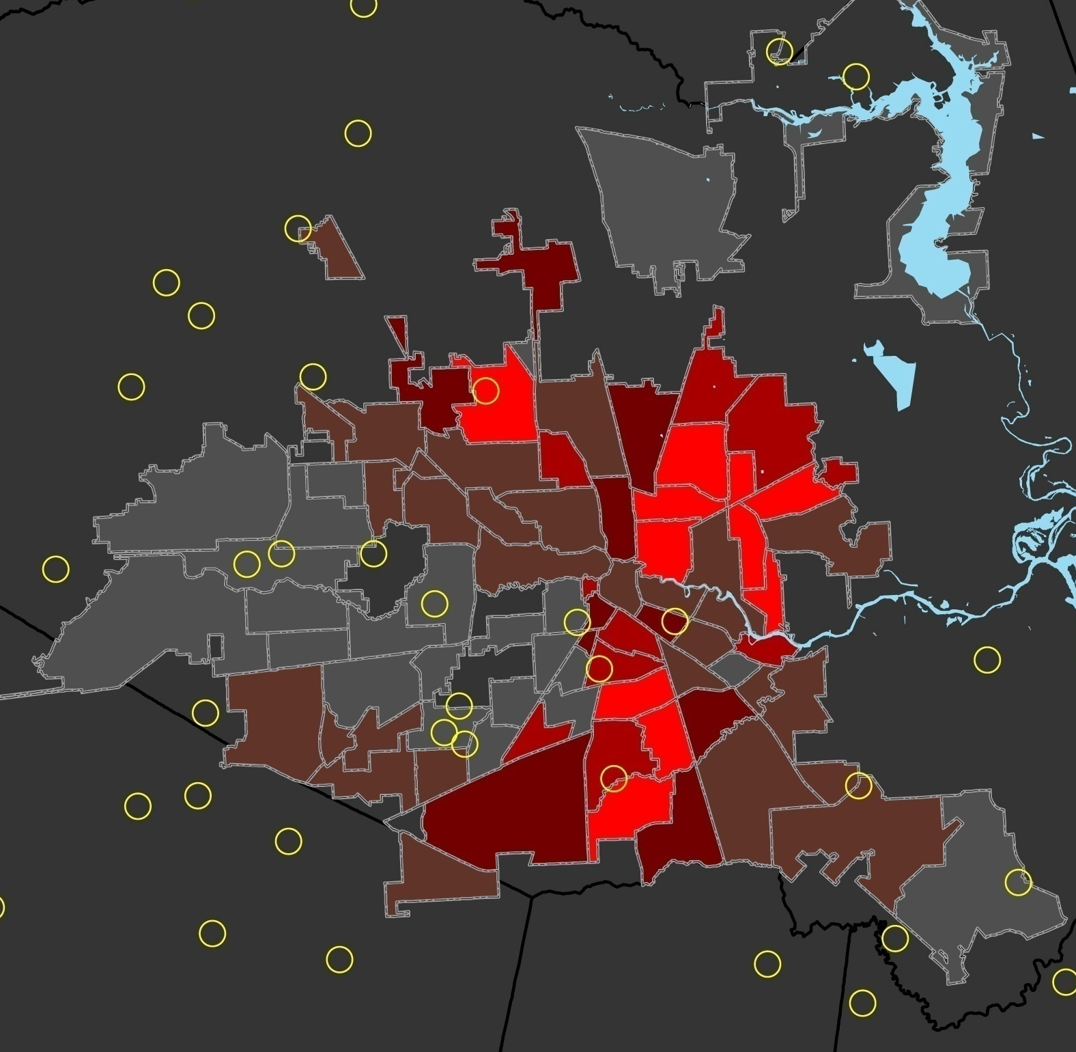
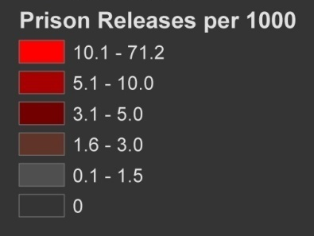
Percent of Students Passing All Tests
High Percentage Schools
Houston
Neighborhoods
Isolating high schools with high percentages of students passing all tests, reveals the pattern of school performance as it relates to neighborhoods with low rates of returning prisoners
www.justicemapping.org
Office Tel: 347.223.2598
Fax: 718.638.2814

Slide 21
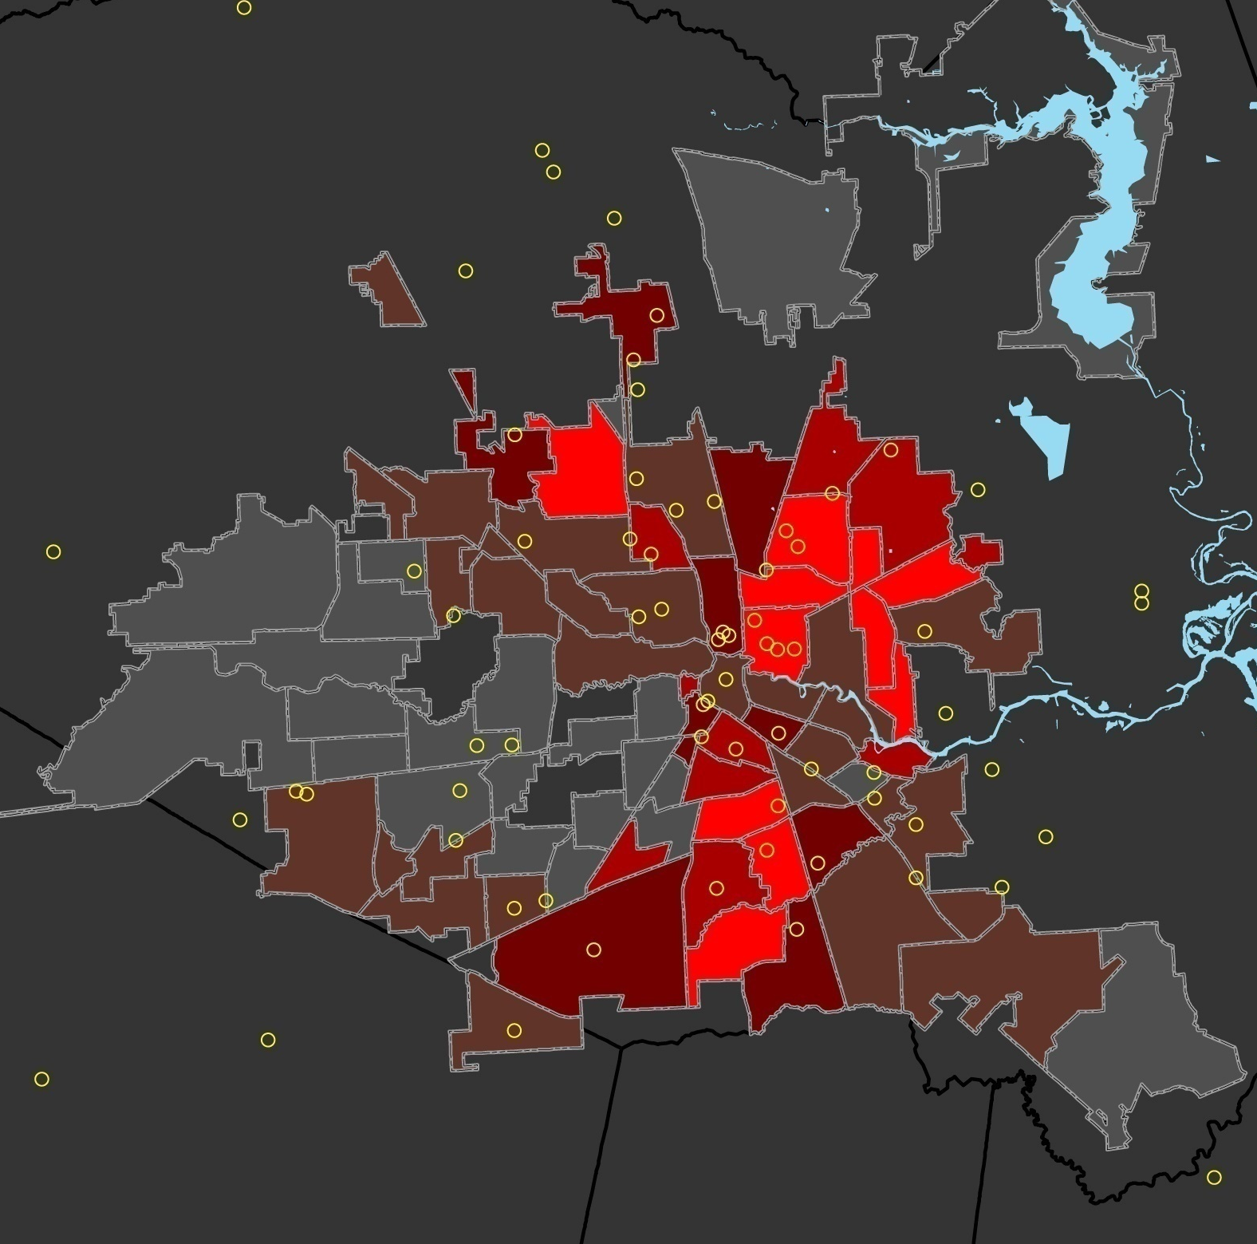
Percent of Students Passing All Tests
Low Percentage Schools
Houston
Neighborhoods
Likewise, isolating high schools with low percentages of students passing all tests, reveals the pattern of school performance as it relates to neighborhoods with high rates of returning prisoners
www.justicemapping.org
Office Tel: 347.223.2598
Fax: 718.638.2814

Slide 22
Annual Prison Expenditure
Houston
Neighborhoods
High reentry neighborhoods experience continual cycling of large proportions of young men between community and prison at an annual cost of millions of dollars per neighborhood.
$9.2M
$12.4M
$8.0M
$10.0M
$13.7M
$9.2M
$8.3M
$11.6M
$7.7M
$7.9M
www.justicemapping.org
Office Tel: 347.223.2598
Fax: 718.638.2814

Slide 23
Michigan and Detroit Neighborhoods
Prison Admissions & Expenditures
Children, Disconnected Youth, Unemployment
www.justicemapping.org
Office Tel: 347.223.2598
Fax: 718.638.2814

Slide 24
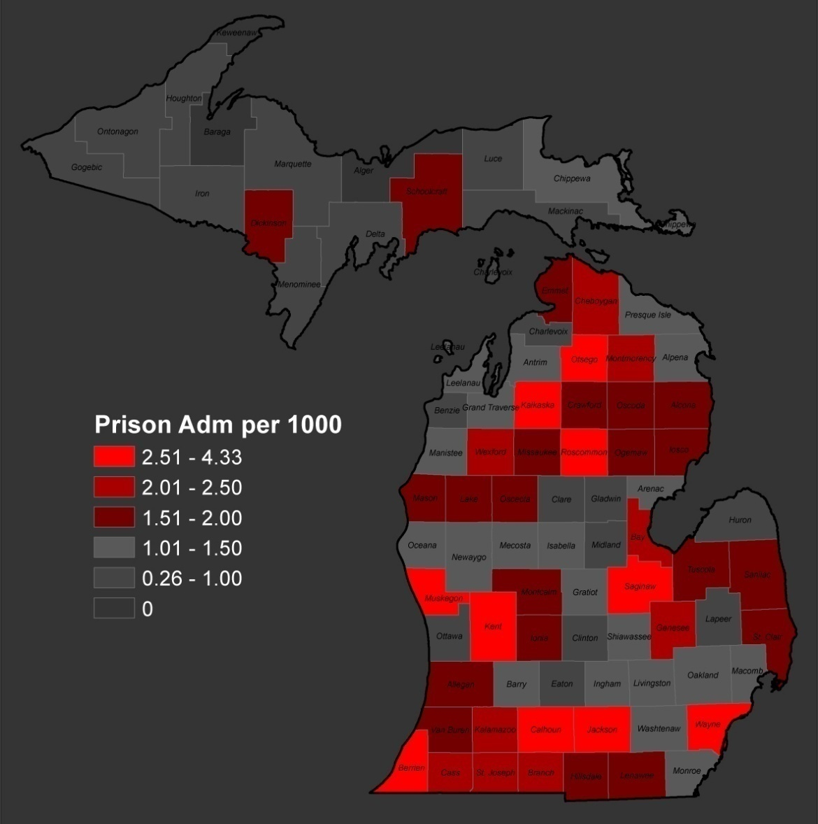
Admissions to Prison (2007)
Per 1000 Adults
Michigan
Counties
Residents of Wayne County account for one-third (33%) of all admissions to state prison.
Counties*
Counties | Prison Admissions | Admissions per 1000
Muskegon | 380 | 4.3
Berrien | 301 | 3.8
Wayne | 3,692 | 3.6
Kalkaska | 28 | 3.4
Jackson | 277 | 3.3
Saginaw | 335 | 3.3
Roscommon | 32 | 3.1
Calhoun | 206 | 3.0
Otsego | 33 | 2.8
Kent | 886 | 2.8
State Total | 11,164 | 2.1
*Counties with admission rates > 2.4 per 1000
JUSTICEMAPPING

Slide 25
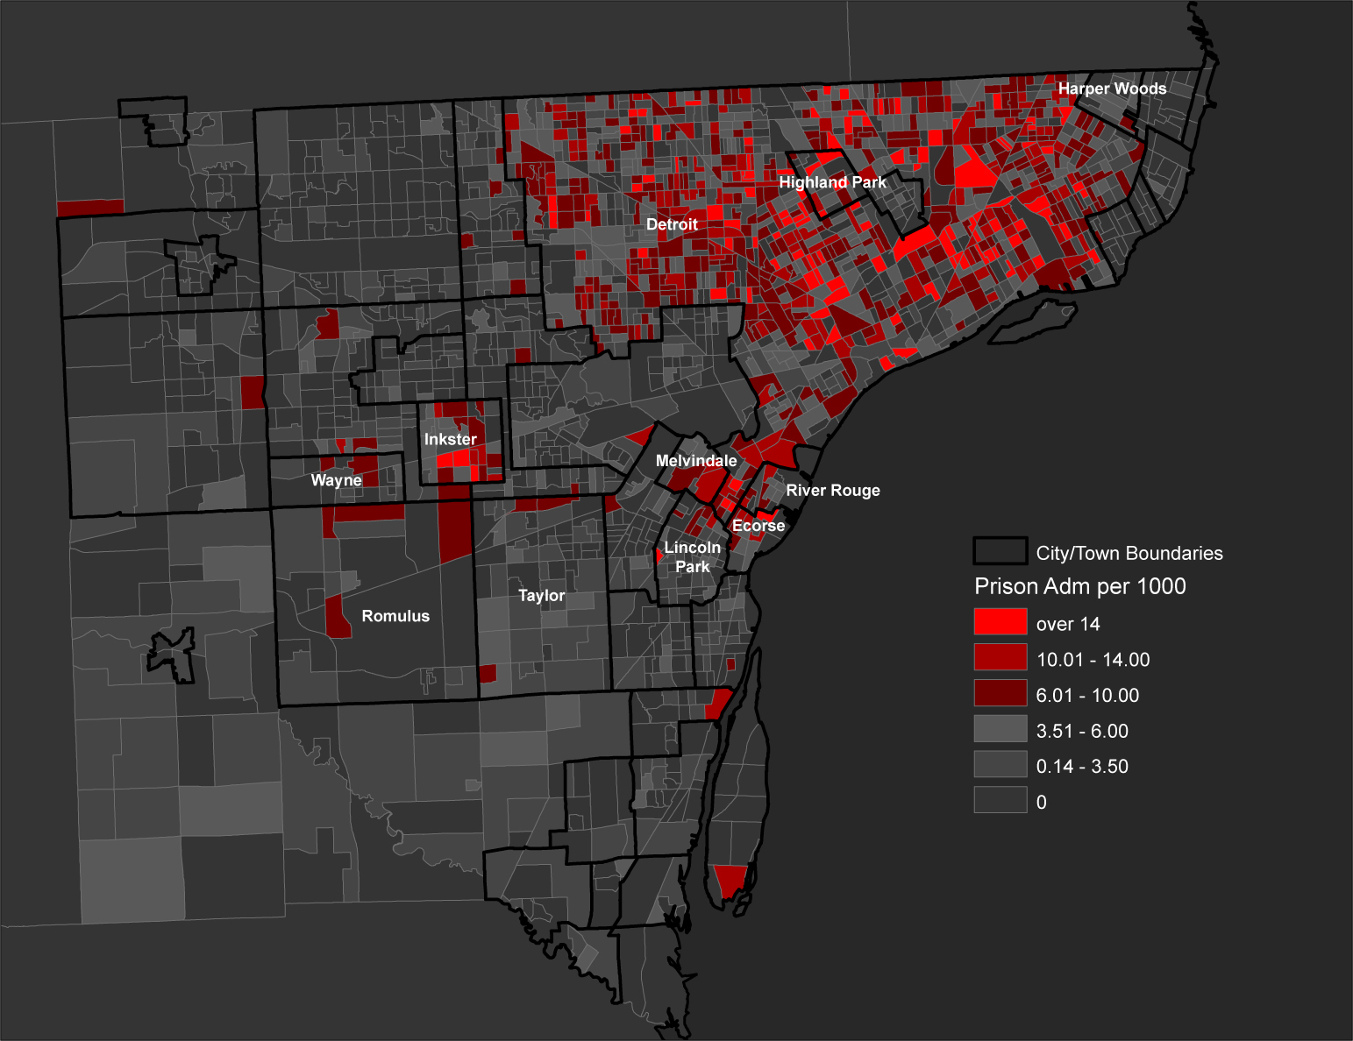
Admissions to Prison (2007)
Per 1000 Adults
Wayne County
Block-Groups with
City Boundaries
Although it accounts for only 46% of Wayne County’s adult population, Detroit accounts for 80% of people sent to prison from the County.
Cities & Towns*
City or Town | Prison Admissions | Admissions per 1000
Highland Park | 53 | 7.4
Ecorse | 37 | 7.1
Detroit | 2891 | 6.6
Inkster | 79 | 5.4
River Rouge | 18 | 4.4
Melvindale | 19 | 3.5
Harper Woods | 16 | 2.4
Lincoln Park | 45 | 2.3
Romulus | 29 | 2.2
Wayne | 21 | 2.1
Taylor | 66 | 2.1
County Total | 3626 | 3.8
*Cities and Towns with annual imprisonment rates of at least 2.0 per 1000
JUSTICEMAPPING

Slide 26
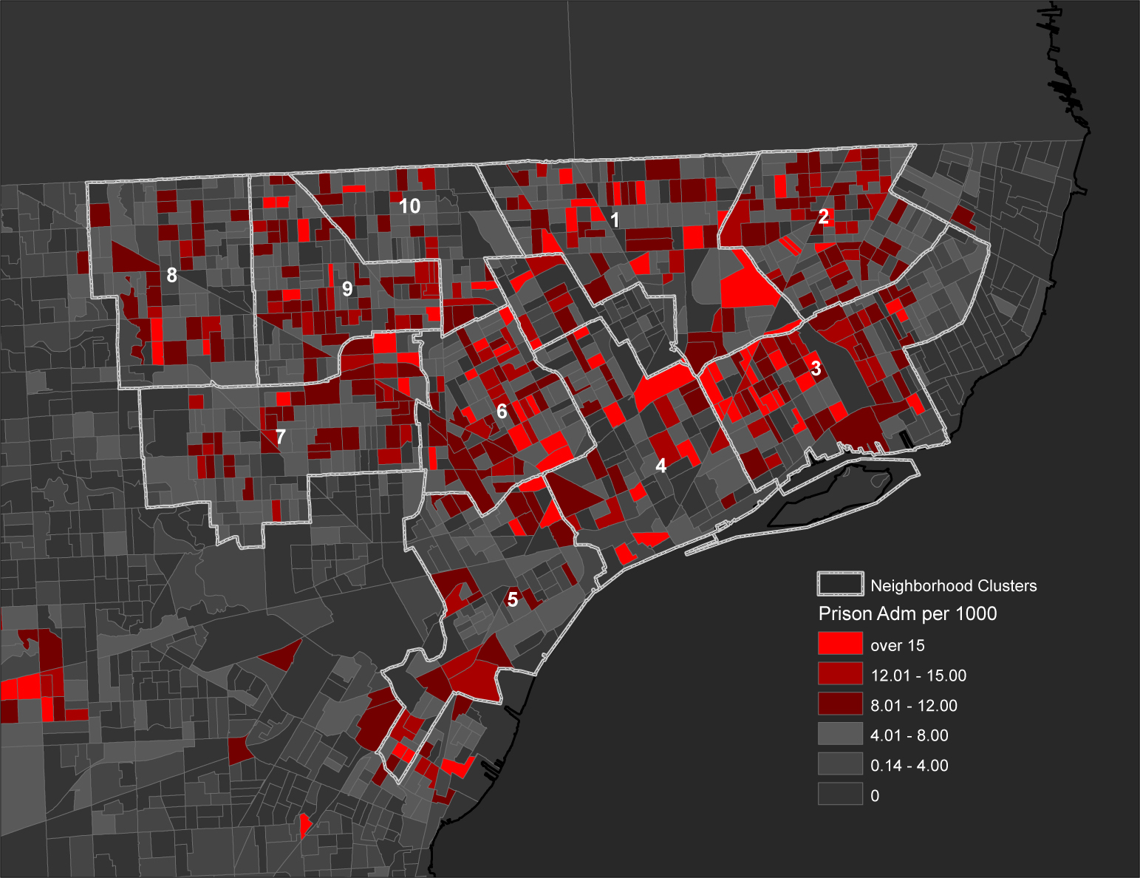
Admissions to Prison (2007)
Per 1000 Adults
Detroit
Block-Groups with
Neighborhood Boundaries
Detroit’s five highest incarceration rate neighborhoods are home to less than a quarter (22%) of Wayne County adults, but account for nearly half (46%) of the County’s total prison admissions.
The highest risk age group is between 20 and 29 years-old.
ADMISSIONS
15
28
AGE
54
Neighborhood Clusters
Nbrhd Cluster | Prison Admissions | Admissions per 1000
6 | 321 | 8.5
3 | 370 | 7.9
2 | 393 | 7.3
1 | 305 | 7.2
9 | 322 | 7.0
7 | 332 | 6.4
4 | 219 | 5.6
5 | 228 | 5.5
8 | 241 | 5.3
10 | 152 | 5.2
Total | 2883 | 6.6
JUSTICEMAPPING

Slide 27
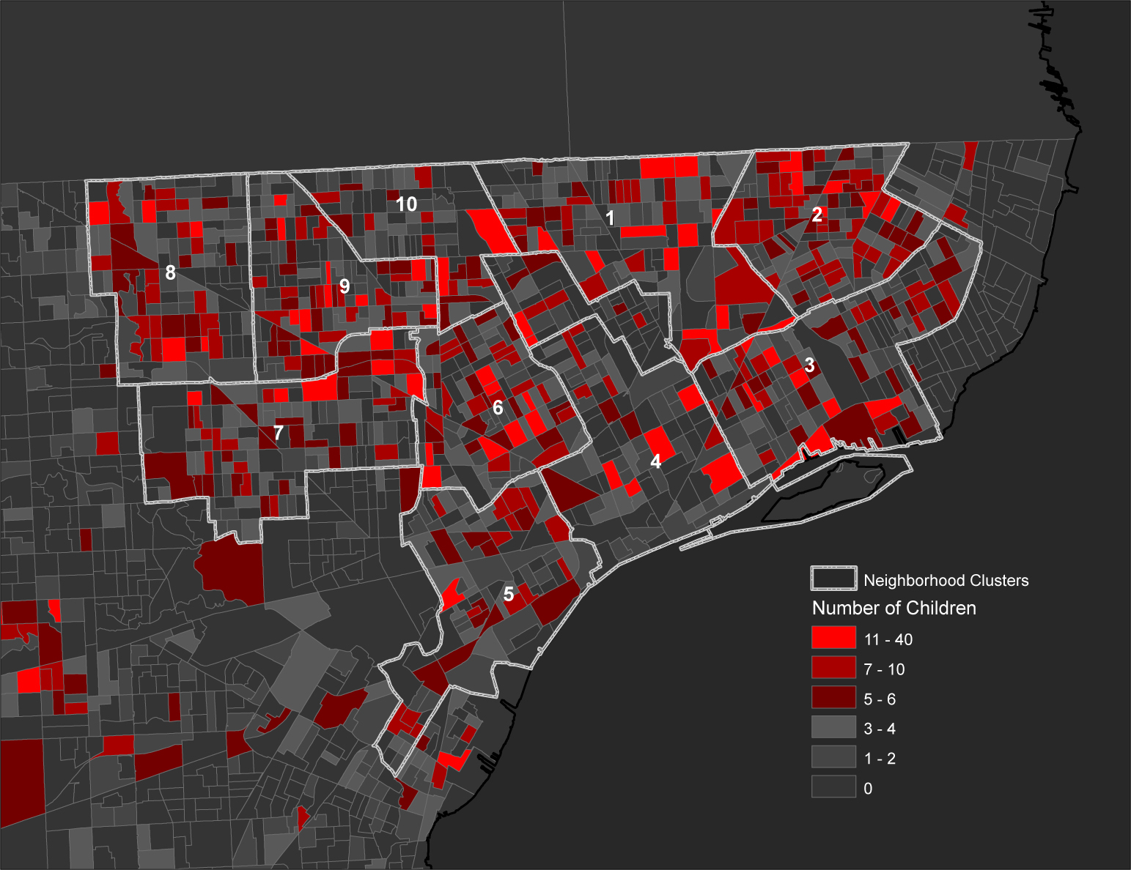
Children with Parents Admitted to Prison (2007)
Counts
Detroit
Block-Groups with
Neighborhood Boundaries
Hundreds of children from each of Detroit’s 10 neighborhood areas lose a parent to prison every year, totaling nearly 4,000 annually. Six of those neighborhoods also suffer disconnected youth rates—16 to 19 year-olds not working, not in school, and who have no high school diploma—above 10%.
Neighborhood Clusters
Nbrhd Cluster | Children with Parent to Prison | Disconnected Youth*
2 | 531 | 10.4%
9 | 481 | 7.8%
3 | 467 | 11.0%
7 | 457 | 8.3%
1 | 430 | 11.9%
6 | 426 | 10.6%
8 | 352 | 5.7%
5 | 282 | 20.8%
4 | 242 | 12.3%
10 | 189 | 4.0%
Total | 3857 | NA
*16 – 19 year-olds, not working & not in school & no HS diploma
JUSTICEMAPPING

Slide 28
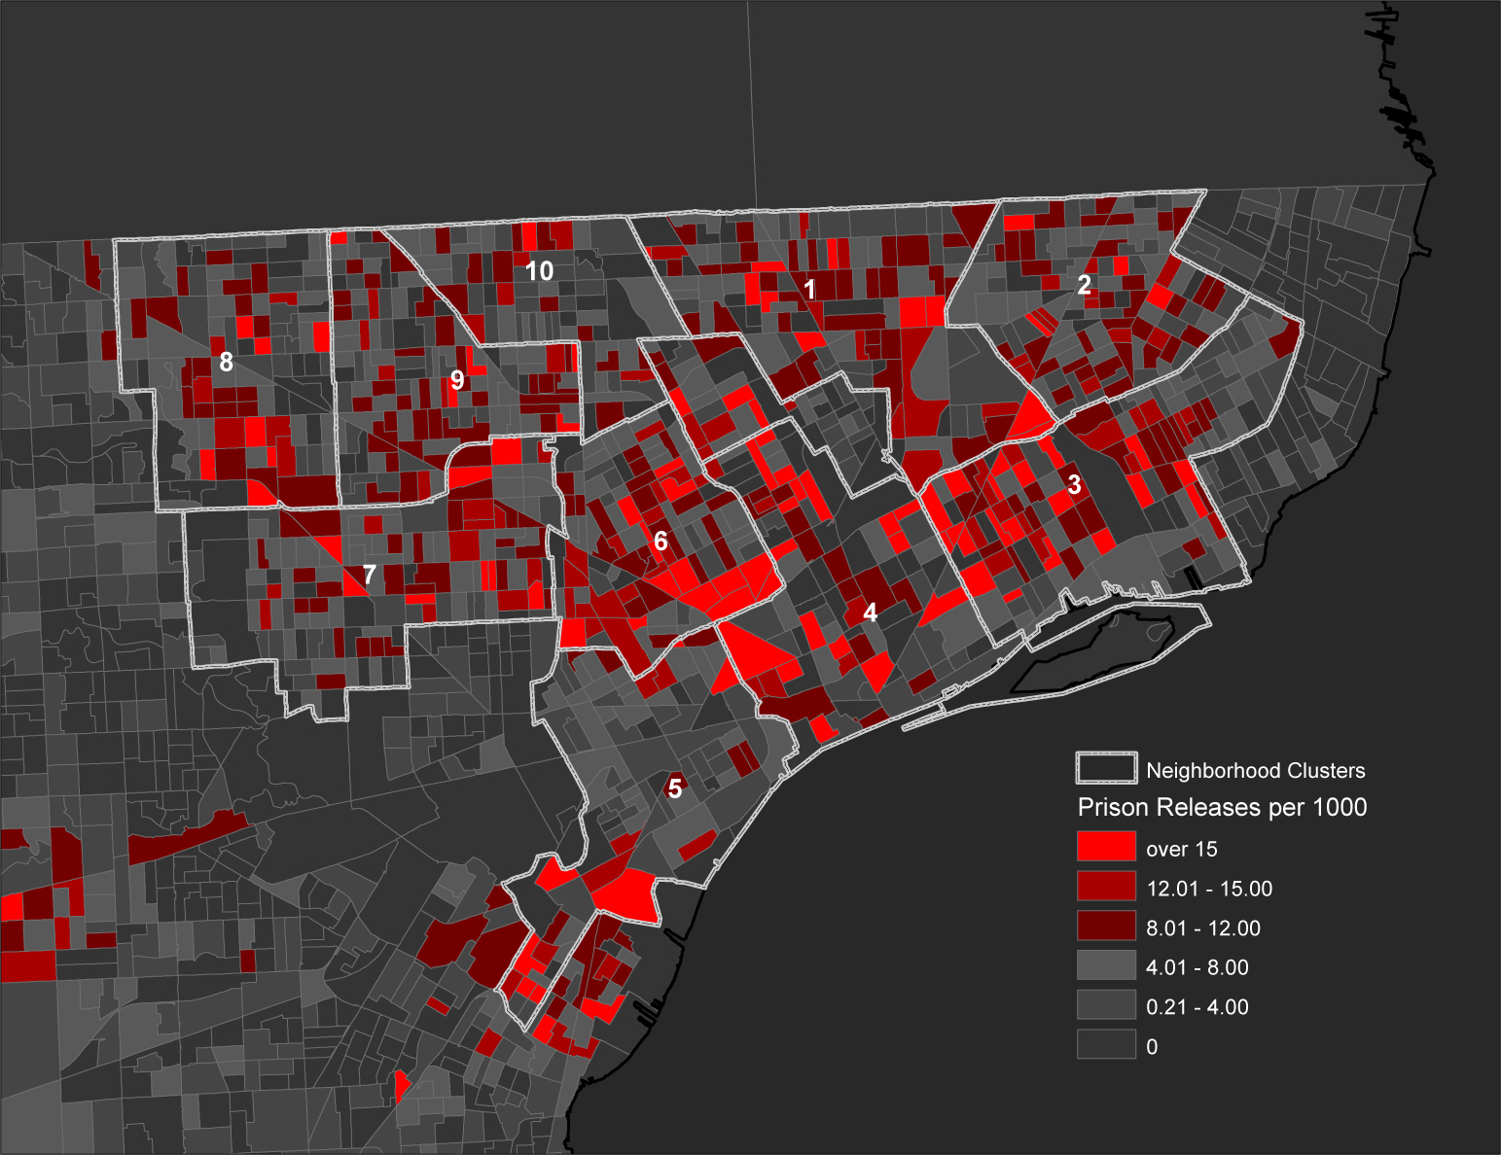
Releases from Prison (2007)
Per 1000 Adults
Detroit
Block-Groups with
Neighborhood Boundaries
Nearly half (44%) of all people returning to Wayne County from prison settle in five high volume reentry neighborhoods, where unemployment rates exceed twelve percent (12%).
Neighborhood Clusters
Nbrhd Cluster | Prison Releases | Releases per 1000
6 | 369 | 9.8
3 | 403 | 8.6
4 | 325 | 8.3
1 | 296 | 7.0
2 | 370 | 6.9
9 | 316 | 6.8
7 | 332 | 6.4
8 | 268 | 5.9
10 | 159 | 5.5
5 | 225 | 5.4
Total | 3063 | 7.1
(12.9%)
(12.5%)
(12.9%)
(14.7%)
(13.8%)
JUSTICEMAPPING

Slide 29
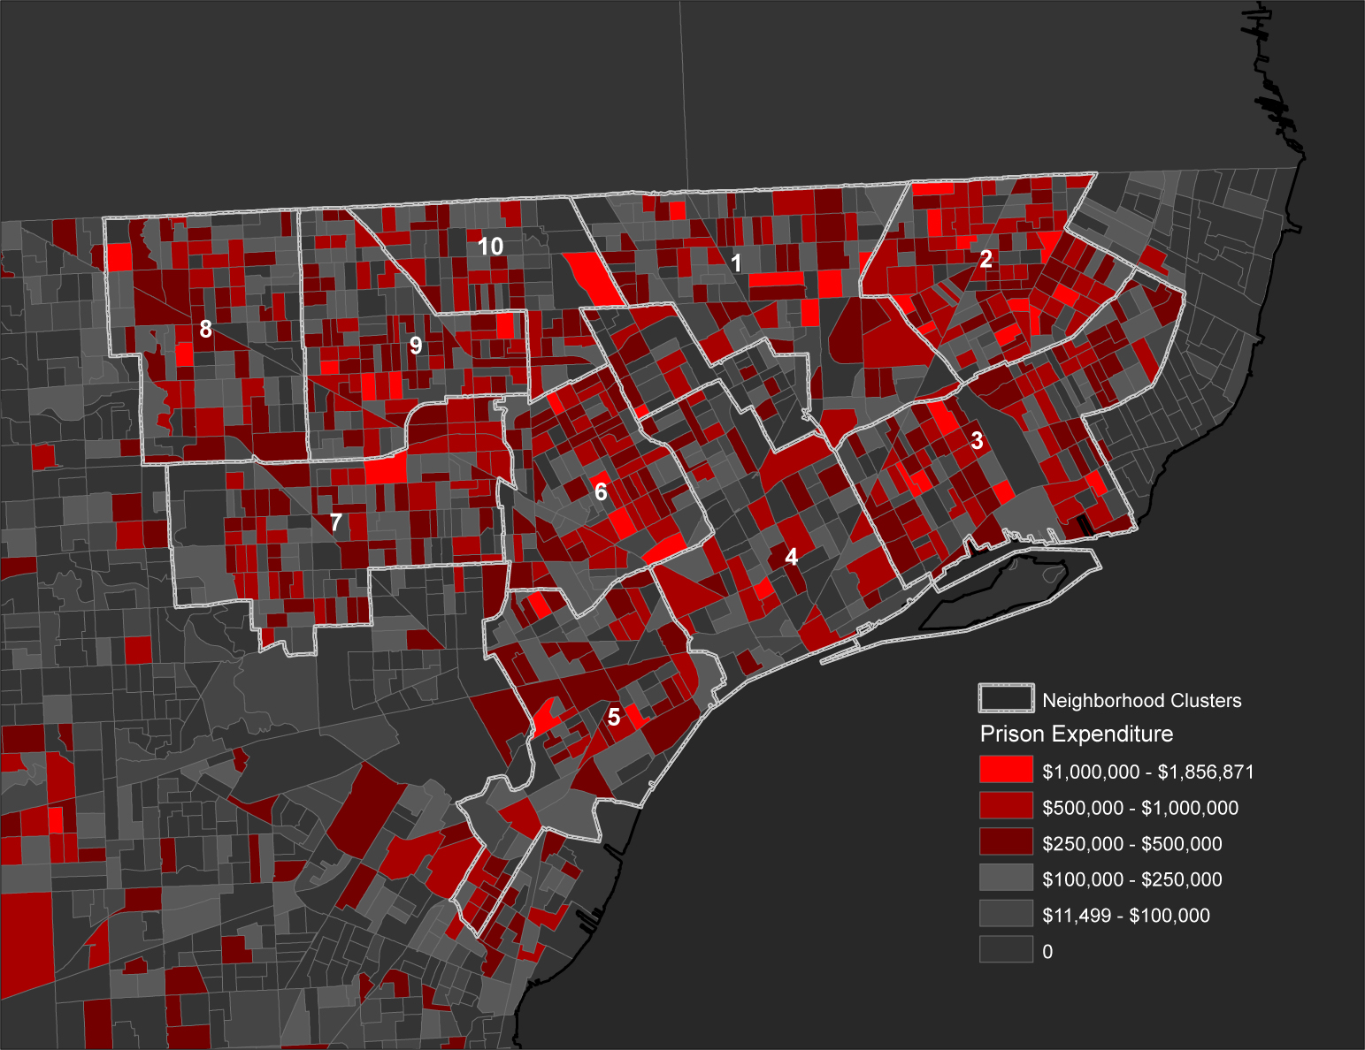
Estimated Annual Prison Expenditures (2007)
Detroit
Block-Groups with
Neighborhood Boundaries
Michigan taxpayers will pay nearly $100 million to imprison residents from just two of Detroit’s 10 major neighborhood areas sentenced in 2007.
Neighborhood Clusters
Nbrhd Cluster | Prison Bed Years | Estimated Annual Expenditure
2 | 1,826 | $54,767,952
3 | 1,425 | $42,758,661
9 | 1,339 | $40,159,956
7 | 1,309 | $39,278,754
6 | 1,195 | $35,852,973
1 | 1,112 | $33,372,543
5 | 949 | $28,458,897
8 | 935 | $28,042,872
4 | 735 | $22,055,238
10 | 603 | $18,101,595
Total | 11,428 | $342,849,441
$18.1M
$33.4M
$54.8M
$28.0M
$40.2M
$42.8M
$39.3M
$35.9M
$22.1M
$28.5M
JUSTICEMAPPING

Slide 30
Las Vegas Neighborhoods
Probationers & Treatment Facilities
www.justicemapping.org
Office Tel: 347.223.2598
Fax: 718.638.2814

Slide 31
www.justicemapping.org
Office Tel: 347.223.2598
Fax: 718.638.2814

Slide 32
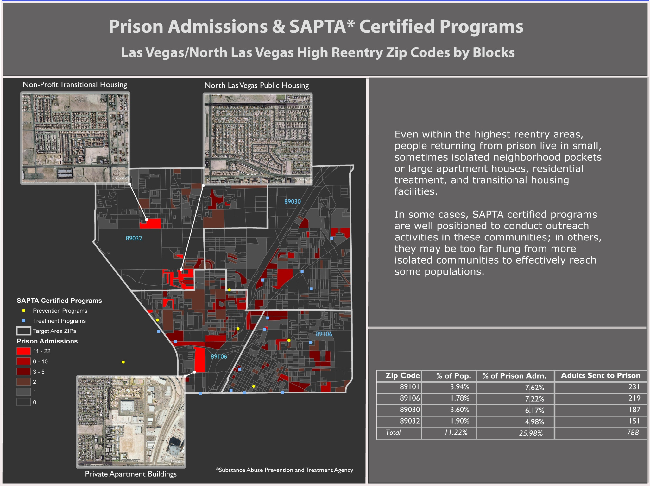
www.justicemapping.org
Office Tel: 347.223.2598
Fax: 718.638.2814

Slide 33
New Media Awareness
www.justicemapping.org
Office Tel: 347.223.2598
Fax: 718.638.2814

Slide 34
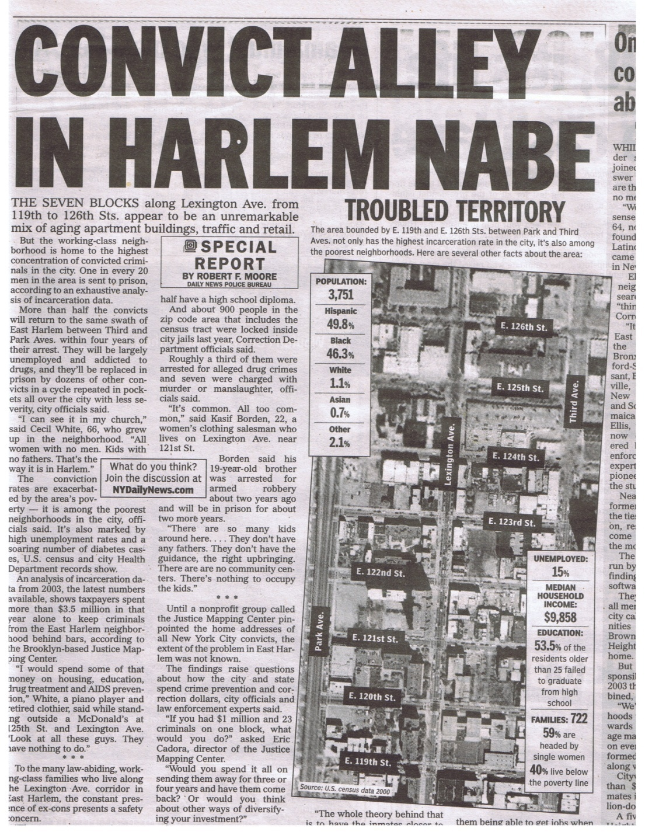
“There are so many kids around here…They don’t have any guidance…There are no community centers. There’s nothing to occupy the kids.”
“The findings raise questions about how the city and state spend crime prevention and correction dollars, city officials and law enforcement experts said.”
www.justicemapping.org
Office Tel: 347.223.2598
Fax: 718.638.2814

Slide 35
“The best way to reduce recidivism is through rehabilitation—not of prisoners but of the neighborhoods that produce them.”
www.justicemapping.org
Office Tel: 347.223.2598
Fax: 718.638.2814

Slide 36
End
Thank You
www.justicemapping.org
Office Tel: 347.223.2598
Fax: 718.638.2814

