Slide 1
Incarceration in American Cities April 9, 2015
Indianapolis, Houston, New York City
The Justice Mapping Center

Slide 2
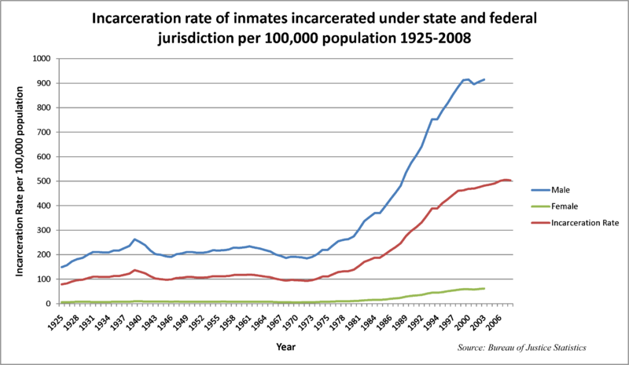

Slide 3
Frenchtown Neighborhood | Tallahassee, FL
Crime Rate
Prison Admissions Rate

Slide 4
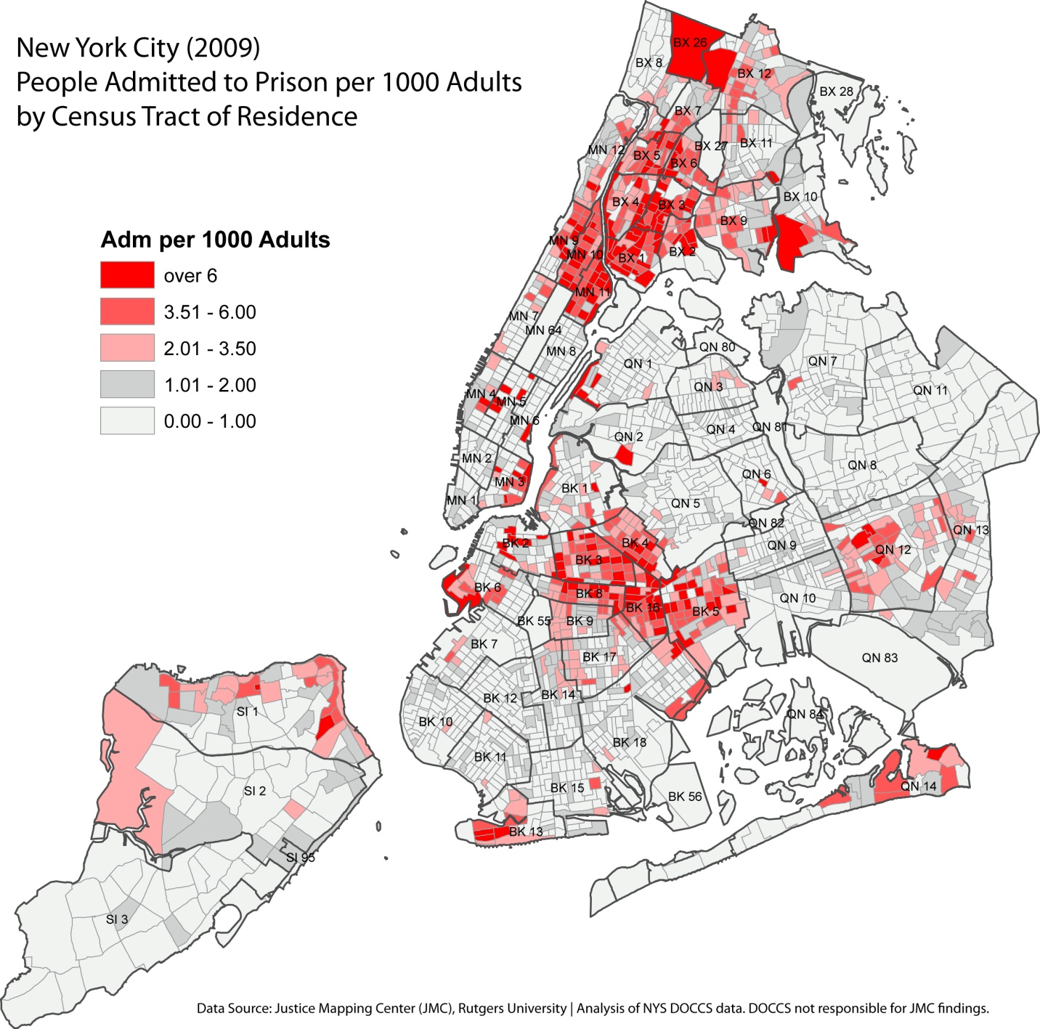
1.8 per 1000 Adults
Admitted to Prison Citywide
19% (Residents)
52% (Prisoners)

Slide 5
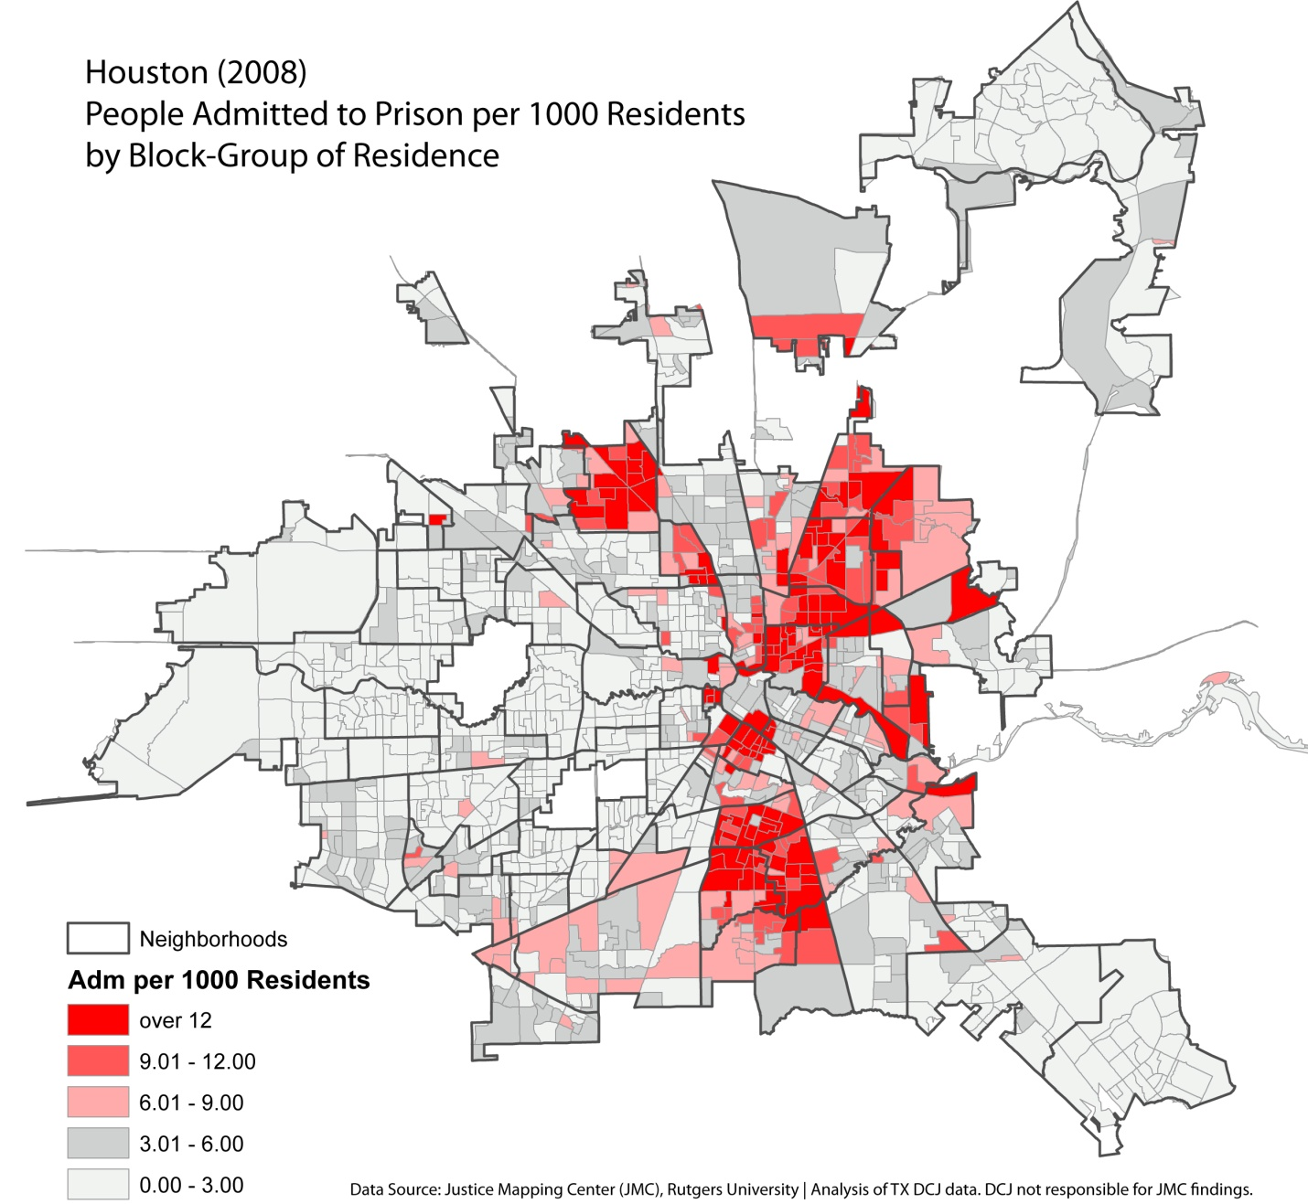
6.3 per 1000 Adults
Admitted to Prison Citywide
19% (Residents)
52% (Prisoners)

Slide 6
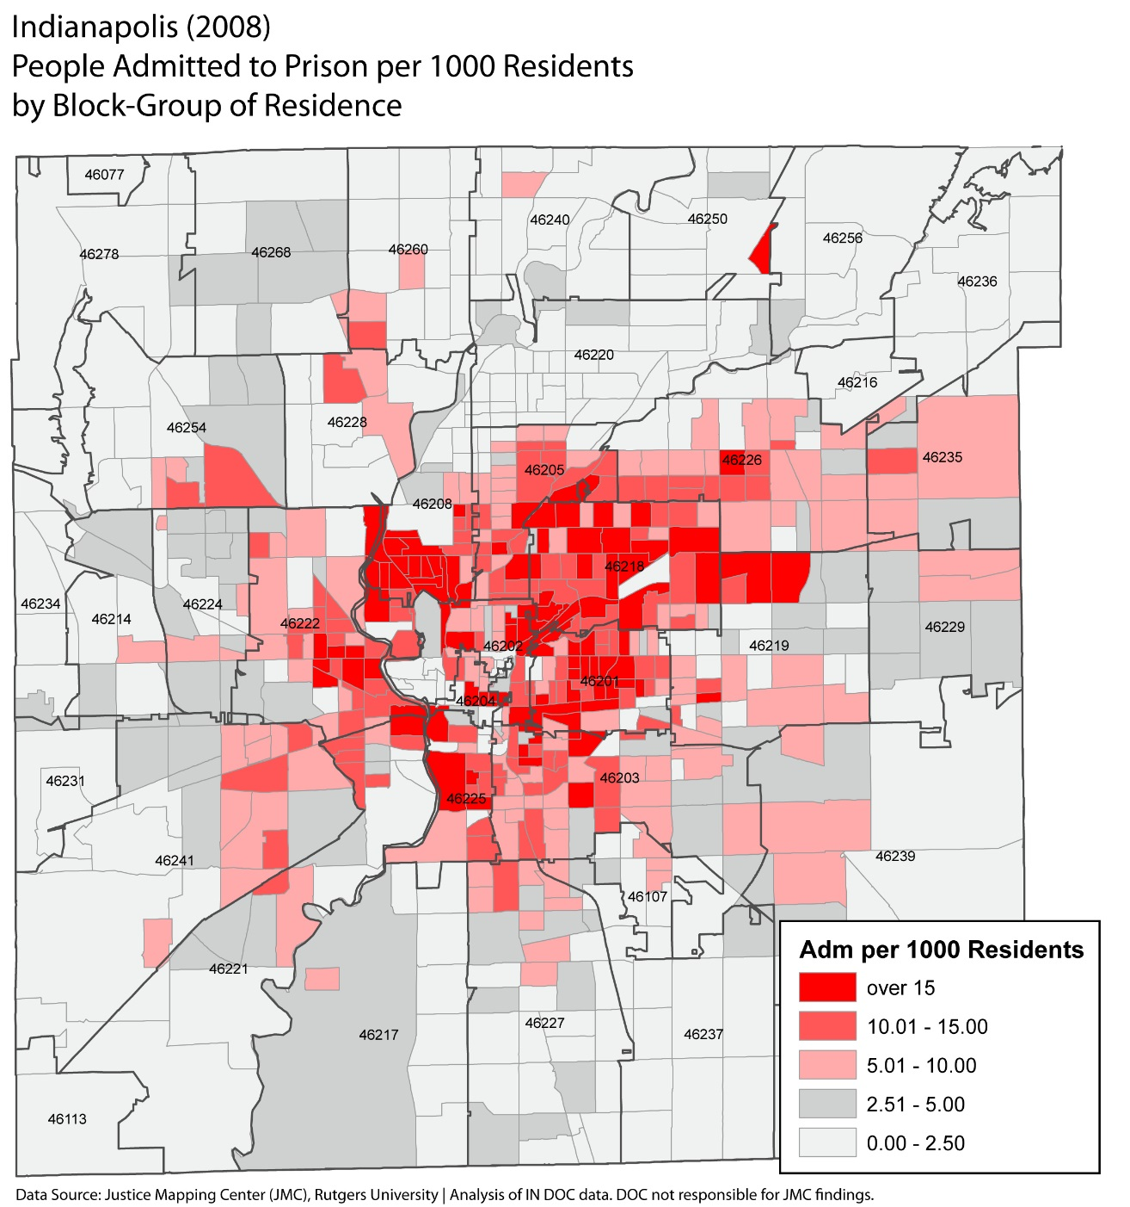
11 per 1000 Adults
Admitted to Prison Citywide
20% (Residents)
50% (Prisoners)

Slide 7
Admissions citywide (1.8/1K)

Slide 9
Admissions citywide (11/1K)

Slide 10
52 Black Adults per 1000 Black Adults
Admitted to Prison
(United Northwest Neighborhood)
11 per 1000 Adults
Admitted to Prison Citywide
United Northwest

Slide 11
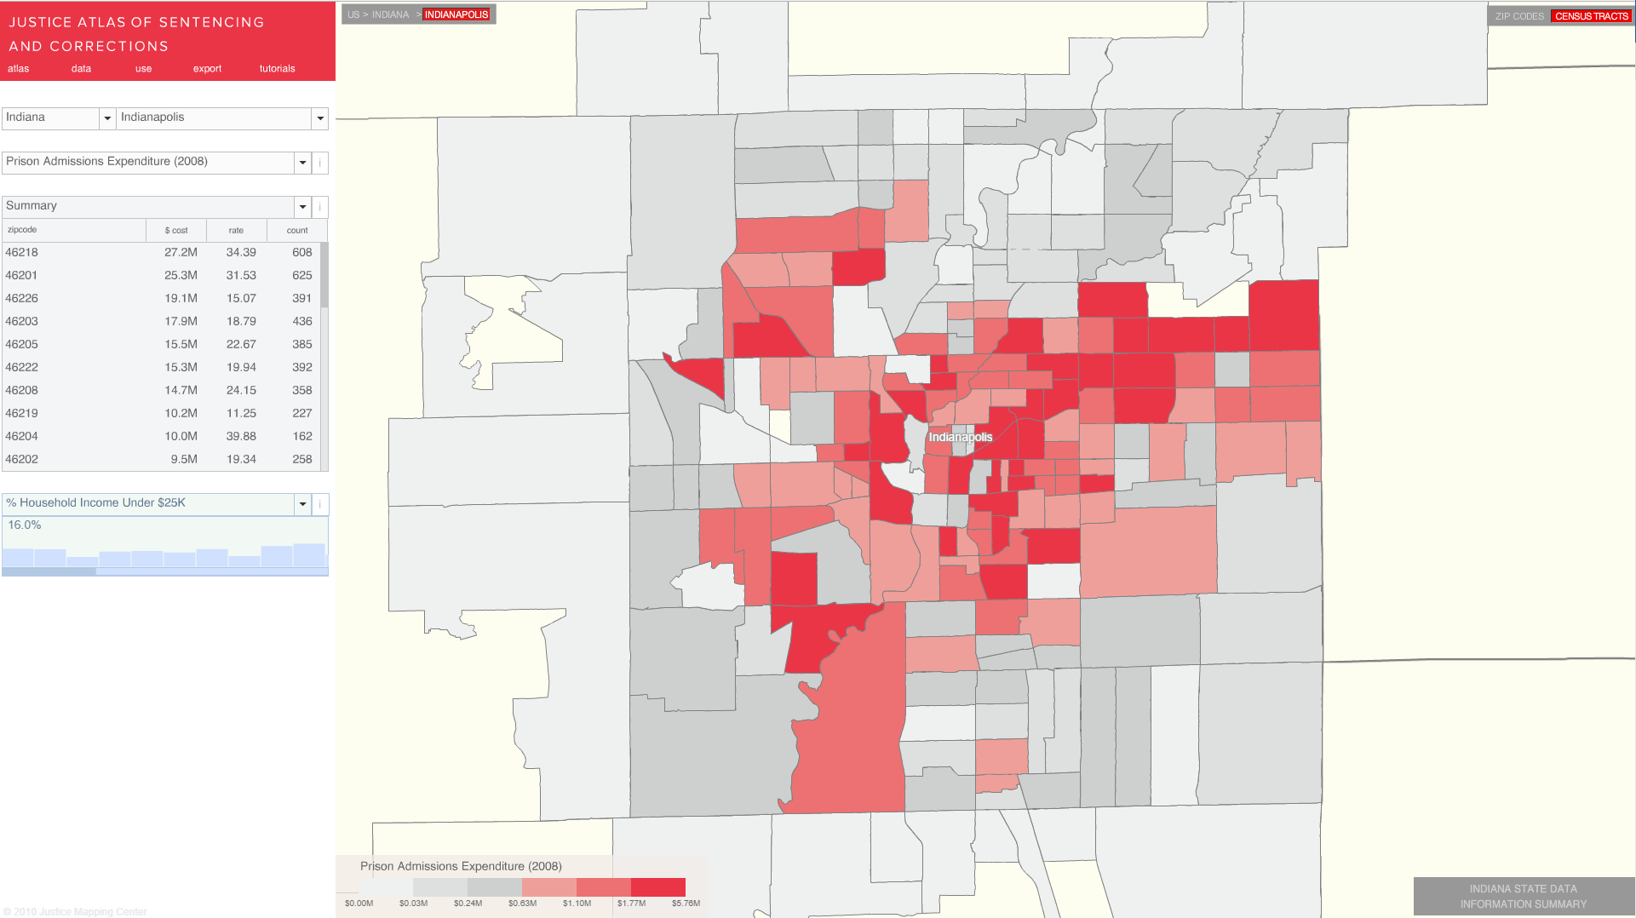
Prison Expenditure | Indianapolis, IN

